Slide 1
My Dream Careers
By: Xia Her

Slide 2
Pediatrician
Being a Pediatrician makes around185,913
I like kids and I love learning new things.
Need 4 years college,4 years of Medical School, and 3 of residency

Slide 3
Agency Nurse
Sometimes choose to work in various capacities at different locations rather than be on staff at a permanent facility
Earn $46,796 and $67,082 as of July 2010.
work independently and in groups.

Slide 4
Medical Assistant
Being a medical assistant there are a lot of duties and responsibility
I like working with people.
I reliable.
Earn from $22,997 to $30,984 per year

Slide 5
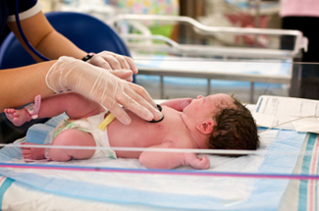
Labor and Delivery Nurse
I want to work with people.
I love newborns.
Earn about 73,000-100,000.

Slide 6
Traveling Nurse
I'd love to travel around the world.
Travel to new place
A traveling nurse salary depends on where the assignment is located. (High hourly wage of $40, low of $30)

