Slide 1
Trip to Puerto Rico
By: Xia,Naomi, && Zertron

Slide 2
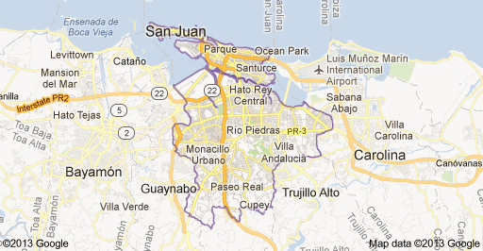
Flight
Date March 7-March 14, 2013
United Airline; $357 each; Total 1,069.20
Depart 11:10 am in San Francisco, CA
7:40 pm stop in Newark, NJ depart 8:15 pm
Arrive at 1:11am on Friday in San Juan, PR

Slide 3
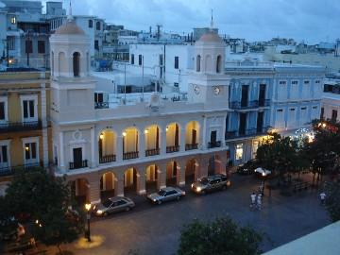
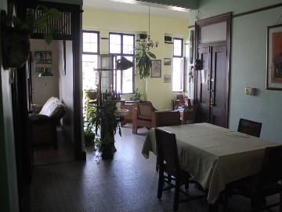
Historic Apartment
We can stay minimum 5 nights.
It is close to a restaurant called La Mallorca
Near a beach called Condado
$750 for 5 nights

Slide 4
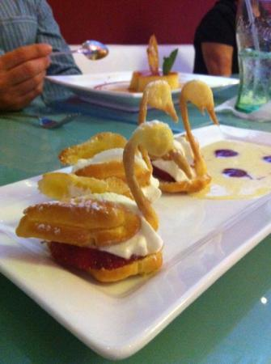
Restaurant
$50-100 each person for food everyday
Rosalia International Cuisine & Tapas ($15 - $33) Breakfast/Brunch, Reservations, Late Night, Private Dining
La Mallorquina

Slide 5
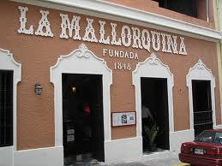
Restaurant

Slide 6
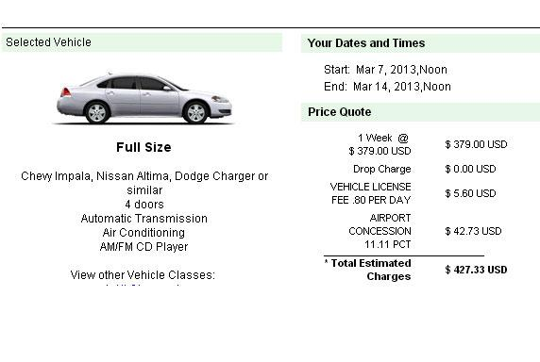
Car rental
~$430
~$300gas
~730T

Slide 7
Day 1 Friday
Condado Beach
Walk around to see what around our apartment

Slide 8
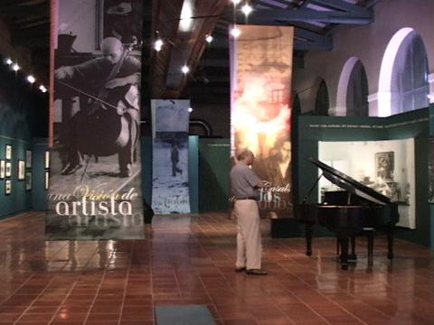
Day 2 Saturday
Museo de San Juan
Museum of Art and History of San Juan
Free Admission

Slide 9
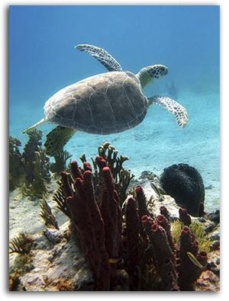
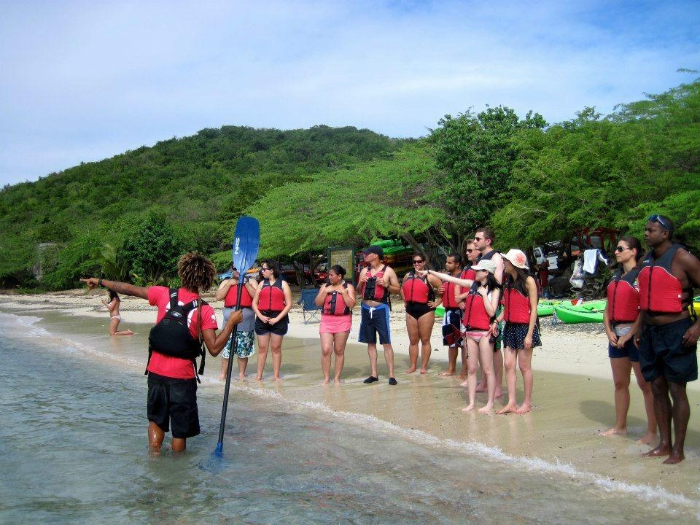
Day 3 Sunday
Culebra Aquafari
Scuba Diving and Kayaking
$69

Slide 10
Day 4 Monday
El Yunque
greatest natural attraction
$5 fee
Hiking and zip lining

Slide 11
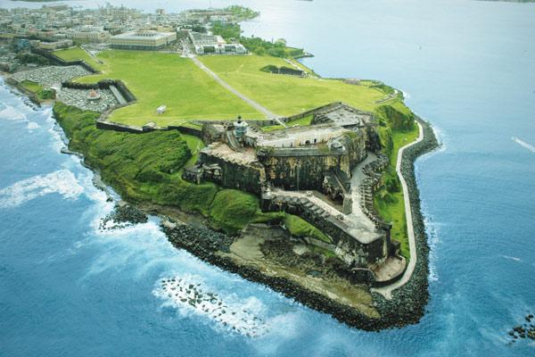
Day 5 Tuesday
El Viejo San Juan
Historic Walking Areas
Shopping, Walking, Nightlife, Dancing, Dining

Slide 12
Day 6 Wednesday
Plaza Las Américas
Shopping
Rest
Pack

Slide 13
Day 7 Thursday
Rest and pack
Depart at 12:45 pm in San Juan Luis Muñoz Marín International Airport
4:46 pm stop in Washington, DC
Depart at 5:25 pm
Arrive at 8:08 pm in San Francisco

Slide 14
Funds
We each started with $1,500 each
Total:$4500
Total Airline tickets: $1,069.20
Total food: $700
Total activities: $300
Car rental + gas: $730
Housing: $750
Total money left: $950.80

