Slide 1
Steelwork Project
Lilyana abina, Deseray Hendrickson, Xia Her

Slide 2
The Client’s Problem..
Wants a creative and innovative designed stair case railing
Discover fresh ideas
To see more exciting creative ideas

Slide 3
Steelwork’s Requirements
The client want’s 2” to 4” wide square tubing for the steelwork
Railing height must be parallel to stair slope 38” to 42” in height
Parallel lines
perpendicular lines and a transversal line over a pair of parallel lines
Linear pairs, Vertical angles, Right and straight angles
Acute & obtuse angles, Complementary & supplementary angles

Slide 4
The Solution
We are going to make the clients wishes come true
We created a staircase railing that has all the clients requirements
The design also has a beautiful creative color stain glass railing meeting with all the angles and lines required

Slide 5
Design 1

Slide 6
Design 2

Slide 7
Design 3

Slide 8
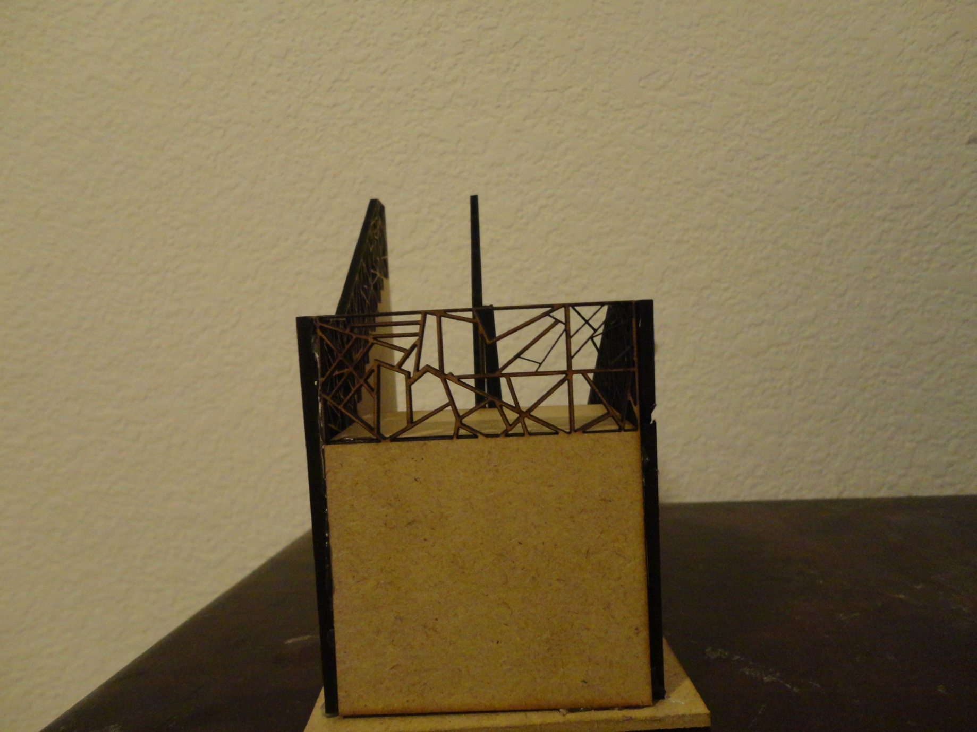
Prototype Design 1

Slide 9
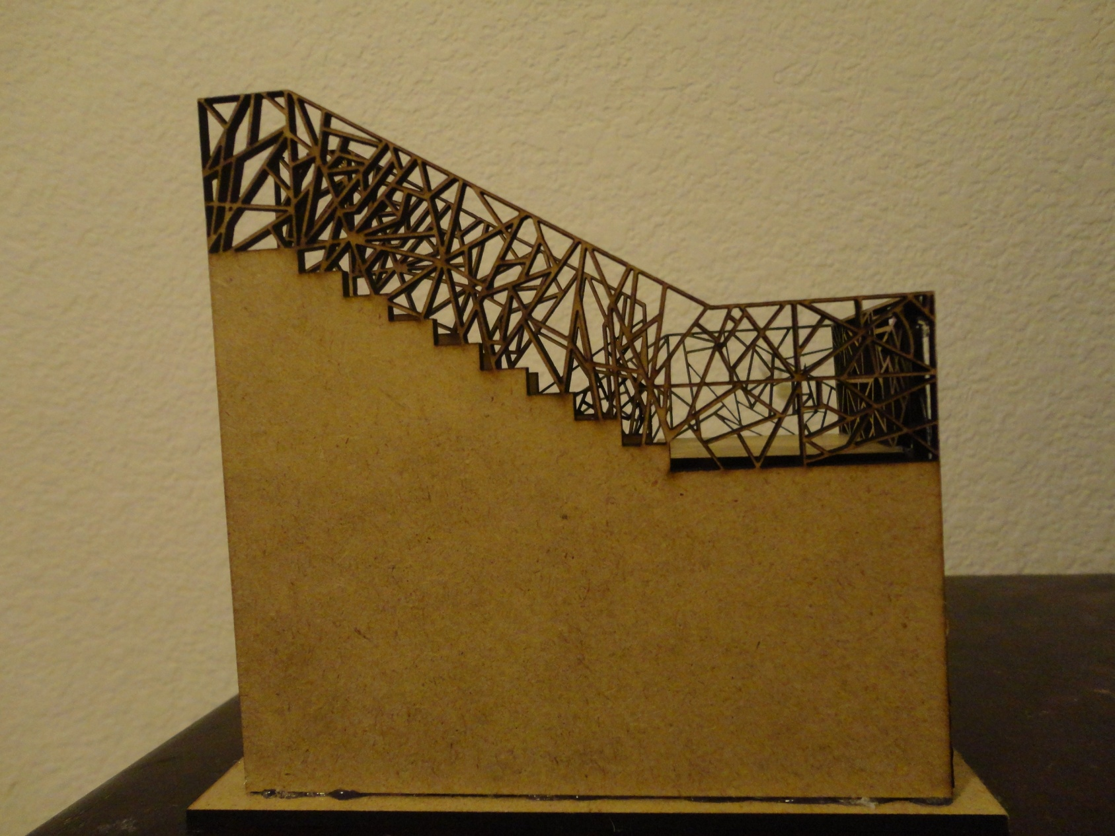
Prototype Design 2

Slide 10
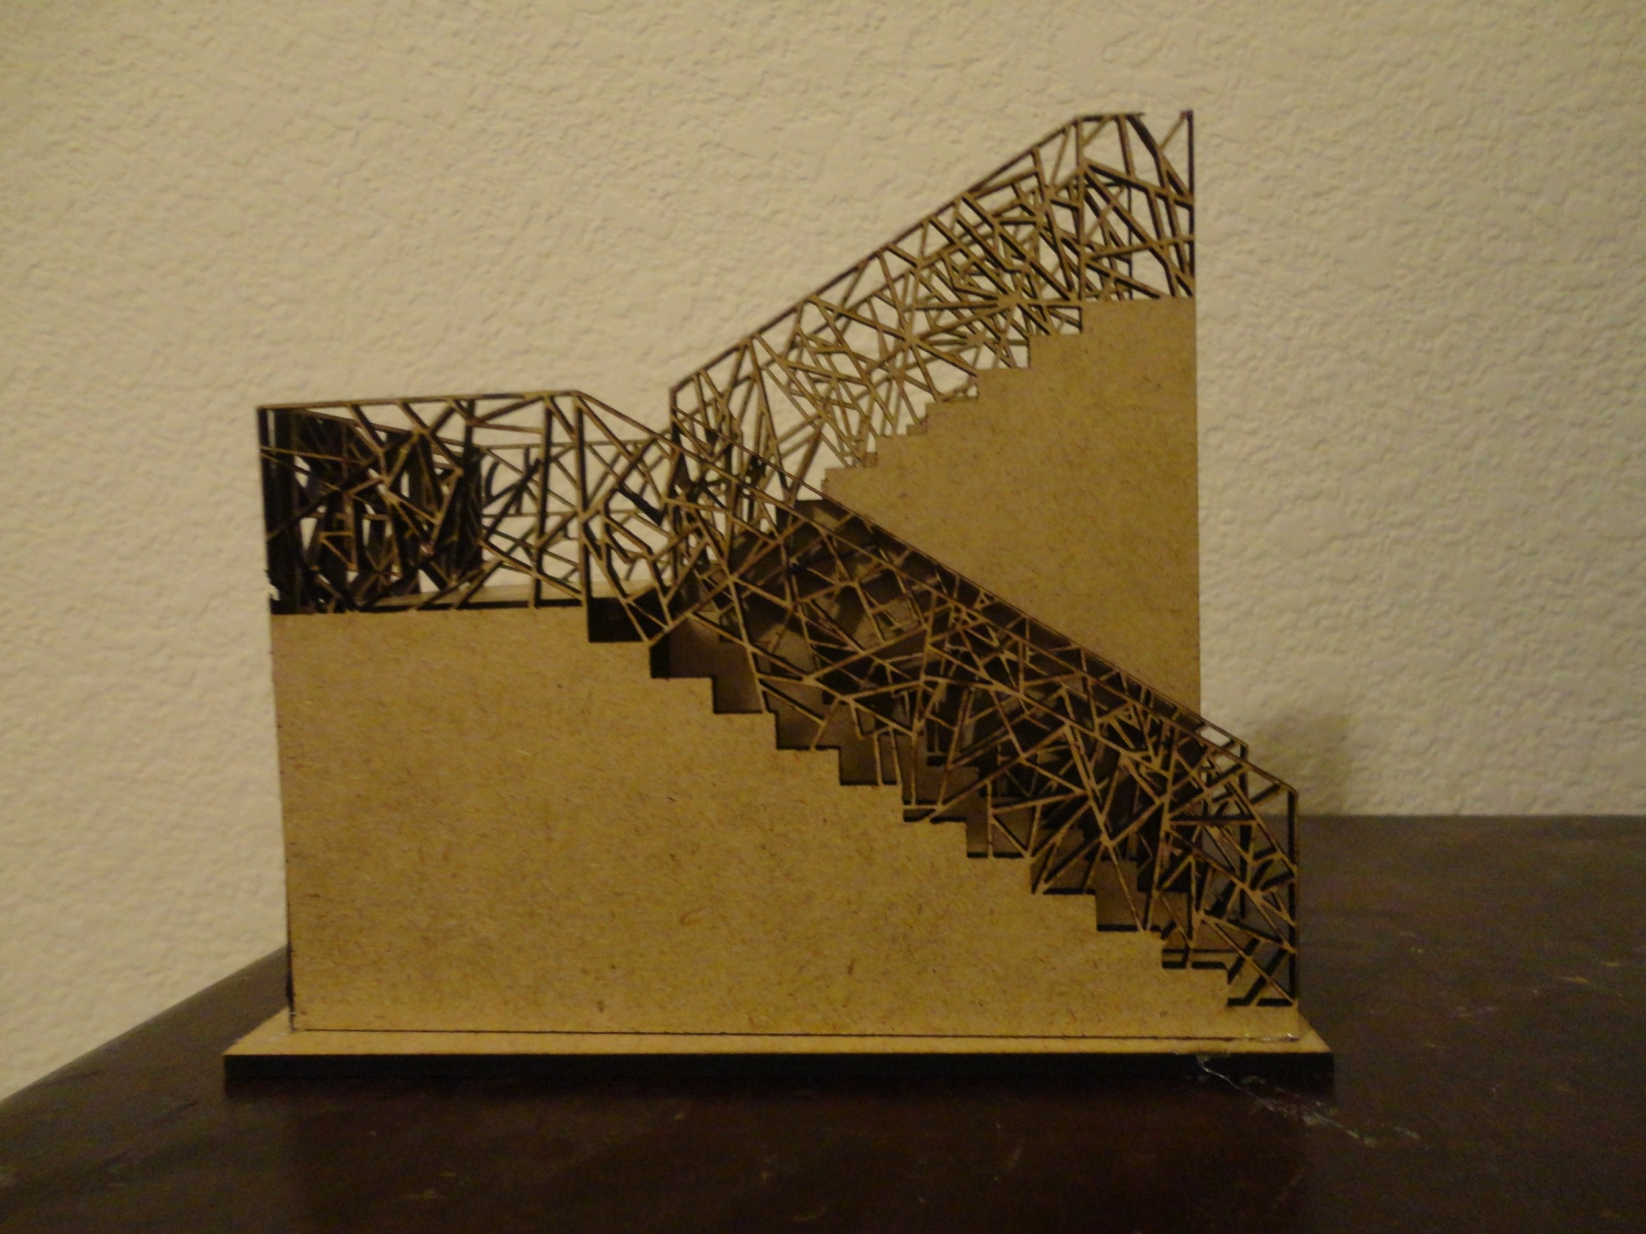
Prototype Design 3

Slide 11
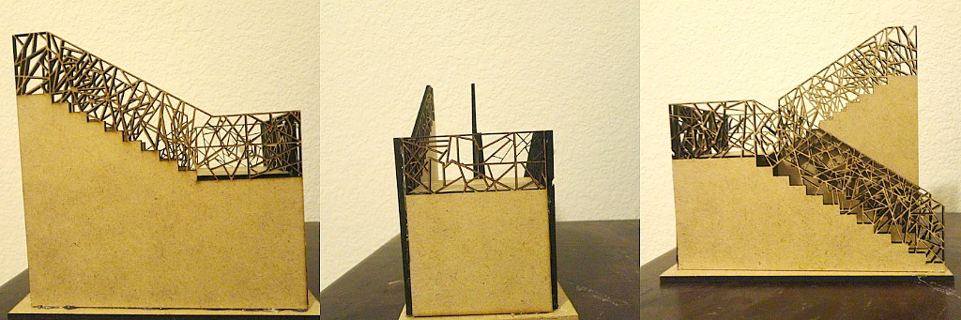
All Prototype Designs

