Slide 1
French Door Project
By:
Xia Her
&
Sarah Rafanan

Slide 2
Ever wish you could change your door?

Slide 3
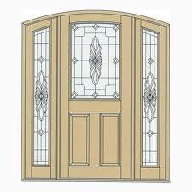
Door like this??
Doors that prevent things from getting inside your house like insects and burglar.
As well as protecting you from harmful things it also beautiful and creativity. You'll enjoy the beauty of it

Slide 4
Client and Problem
Client is Milgard
Want to expand their selection line up
Want door to be made of all the seven types of triangles
Want congruent triangles and transformation patterns of translation, rotation, and reflection

Slide 5
Translation Design

Slide 6
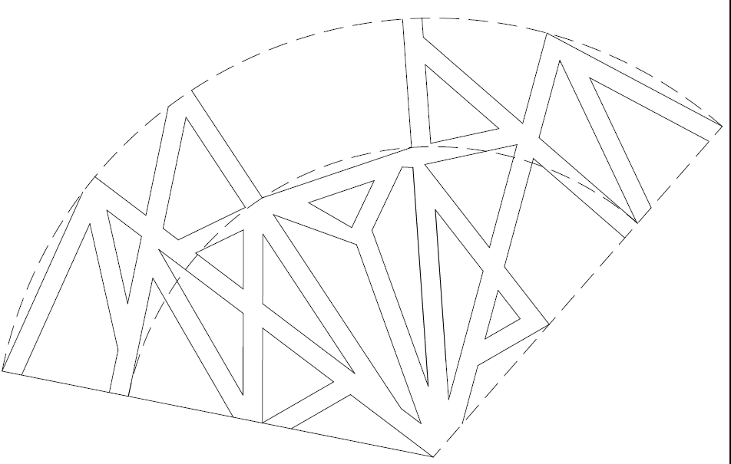
Rotation Design

Slide 7
Designs together

Slide 8
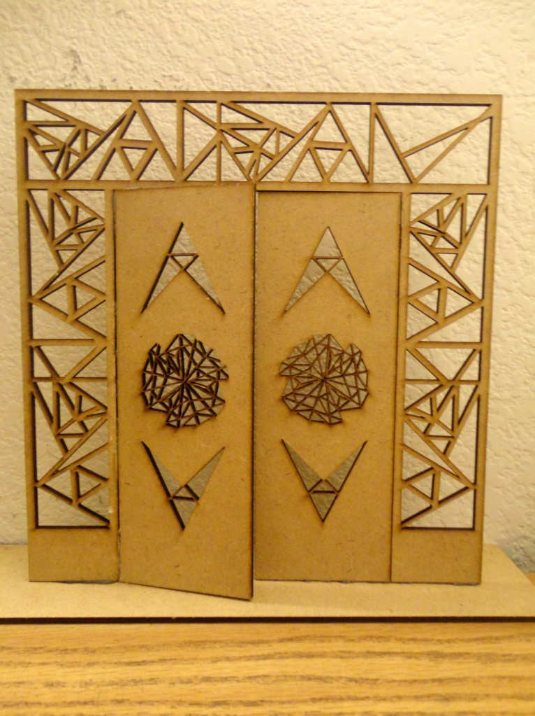
Finish Product

Slide 9
Solution
Milgard wants to create new doors designs to help expand their selection line up
We designed a French Door using all seven types of triangles
The design have congruent triangles and transformations as wanted
We hope that they like our door

