Slide 1
Evolo 2012 skyscraper competition
By: Xia Her, Islam Nasyrov, and Emma Wentzel

Slide 2
hook
Ever wonder what it takes to build a skyscraper?

Slide 3
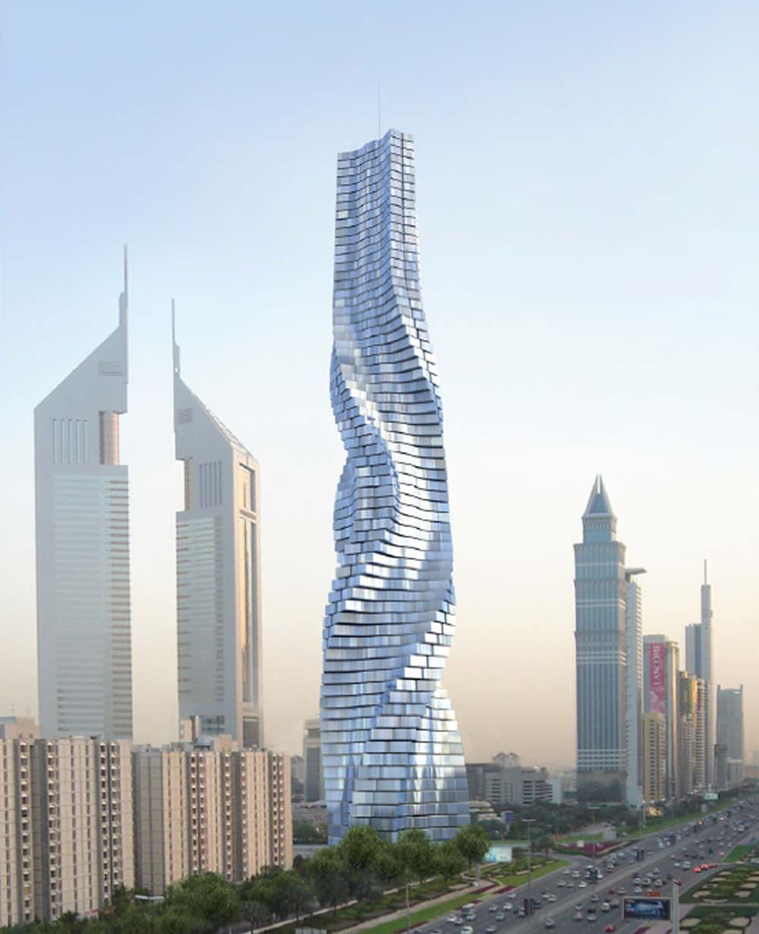
Client and requirements
eVolo(an architecture magezine) has annual skyscraper competition
Mrs. Hanzel wants students(us) to do a dry run
Footprint must include:
Quadrilaterals(Square, Rectangle, Parallelogram, Rhombus, Kite, Trapezoids)
Regular Polygons(Pentagon, Hexagon, Octagon)
Circle/Semi-Circle
Triangles
Must be able to calculate data:
Area of each floor
Total area of building
Volume of each floor
Totally volume of building
Interior surface area of each floor
Total interior surface area

Slide 4
Driving questions
How do we design a building’s footprint that has radial symmetry & compound shape?
How do we design a tall building to withstand high wind velocity & be structurally solid at the same time?
How do builders estimate the total construction cost of a building?
How do interior designers estimate cost of “finishing” permanent walls of a building?
How do mechanical engineers calculate the heating or cooling requirements of a building?

Slide 5
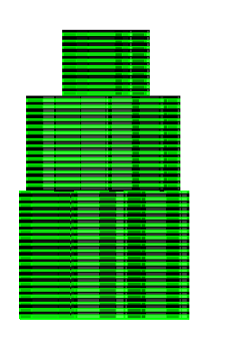
3-D Model

Slide 6
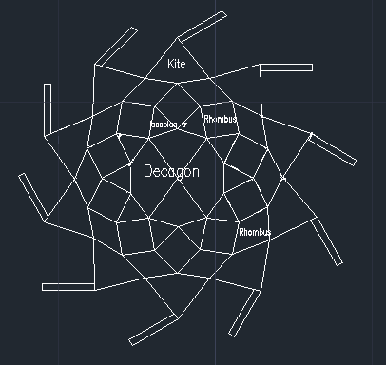
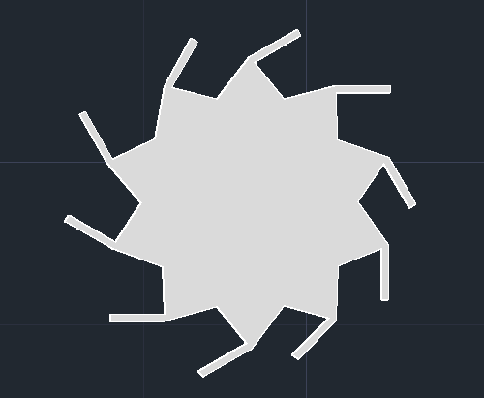
2-d 1st floor

Slide 7
2-d footprint 2nd floor

Slide 8
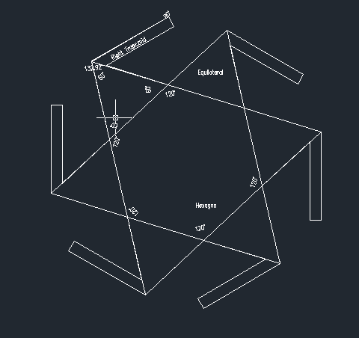
2-D footprint 3rd level

Slide 9
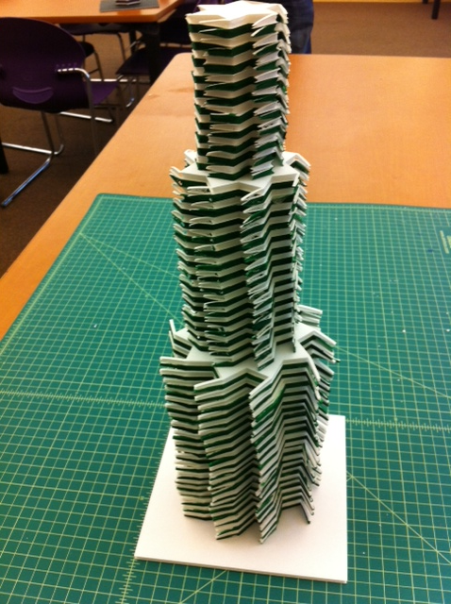
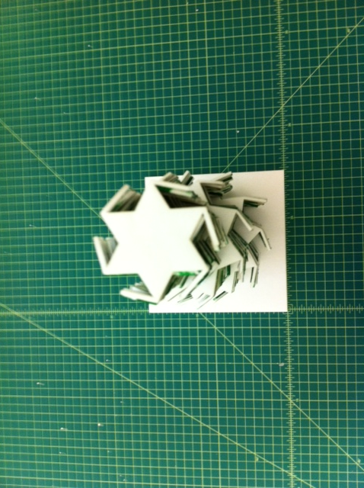
prototype

Slide 10
Summary/solution
Mrs. Hanzel asked for us to do a dry run of the eVolo Skyscraper Design Competition
Had to make footprint for a skyscraper

