Slide 1
Earth’s Orbit Around the Sun
By: Xia Her & Lilyana Abina

Slide 2
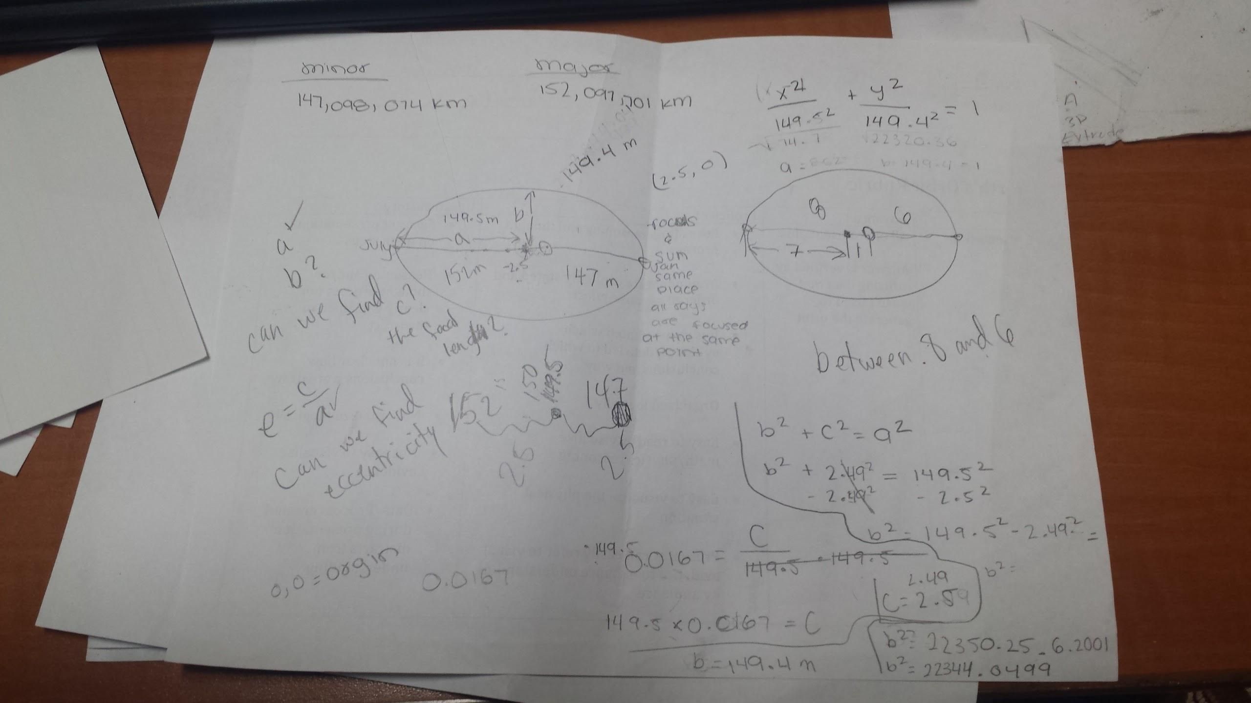
Math

Slide 3
Final
Minor: 147,098,074km
Major: 152,097,701km
A:149.5m
B:149.4m
C:2.49m

Slide 4
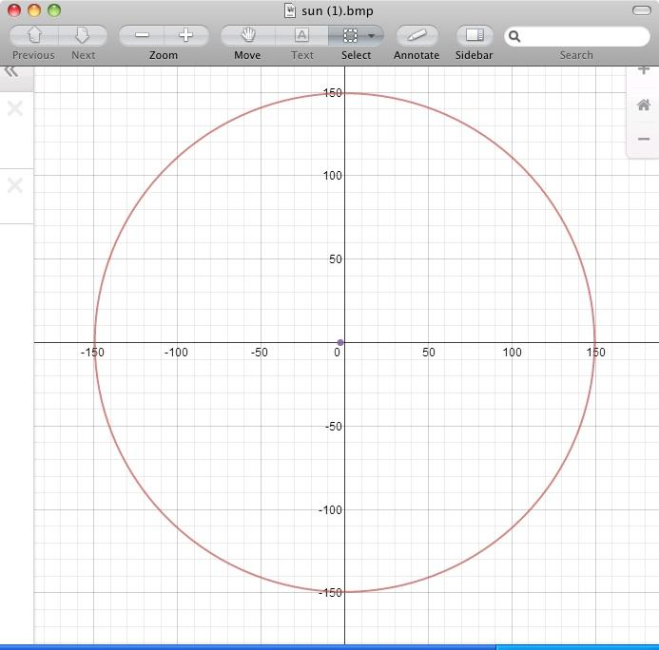
Graph
x^2/149.5^2+
y^2/149.4^2=1

