Slide 1
My Dream Jobs
By: Xia Her

Slide 2
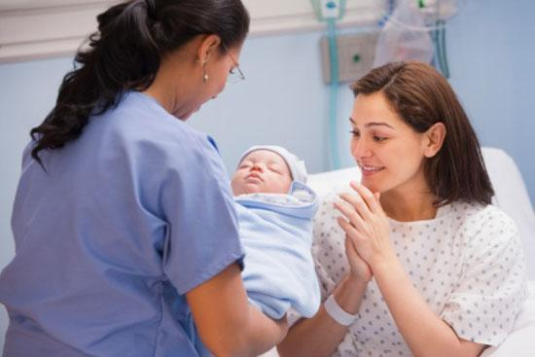
First Dream Job
Labor and Delivery Nurse
I had experience with babies (a lot)
Babies are cute especially newborn
Easier to take care of

Slide 3
Skills Require
Patience ( be able to control myself)
Reliable
Cares for other (take care of mother and her baby)
Fast Pace
Active Listening
Be good in Critical thinking, communication, and decision making skills
Coordinating with physicians to provide the best care plan for each patient.
Monitoring the mother and baby before, during, and after labor
Teaching mothers how to care for themselves and the new infant
Providing emotional support to the mother and family

Slide 4
Educations
must have an RN license (make more money than an LPNs, also depends)
with a Bachelor of Science in Nursing (BSN) takes 4 years of college
Associate Degree in Nursing (AND),
hospital diploma
Education in neonatal resuscitation (checking on the baby constantly) and fetal monitoring

Slide 5
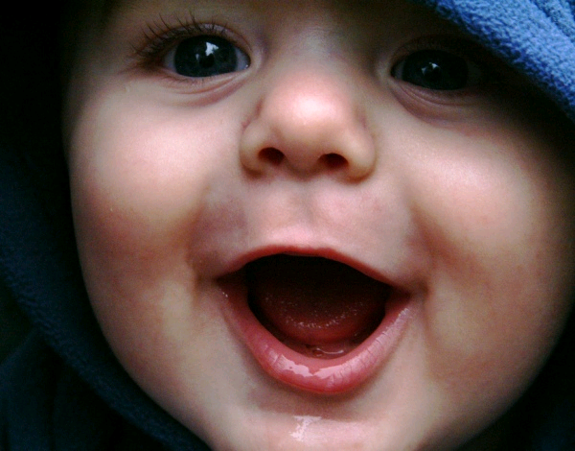
Why it interest me?
Newborns are cute and their easier to take care of
Get to work mothers and their babies
The average yearly salary $55,000 a year.
Several years of experience makes $70,000 or more
High educated makes more money

Slide 6
Second Dream Job
Location Scout ( works for manager) / Location Manager (talks with the director)
Photography
Travel to different places to take pictures
I get to pick places to film movies (I have to convince them why it’s perfect)

Slide 7
Skills Require
Patience
Photography skills
A lot traveling
Reliable/ responsible
Convincing
Understanding Health and Safety regulations
Able to work long hours
without complaints
Have a lot of options for director
to choose (5 – 10 options)

Slide 8
Educations
Photography skills
Take art college (not necessary)
Attend film school and have a general knowledge of the film industry and the production process

Slide 9
Why it interest me?
I get to travel a lot!
See different places
Salaries varies depends on experiences
Average $48,000 (Los Angeles)

Slide 10
Change in Heart

