Slide 1
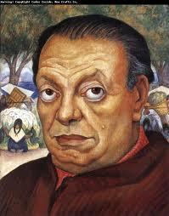
Diego
Rivera
By: Xia Her, Naomi Jones, Zertron Vang

Slide 2
About Diego Rivera
Born on December 8, 1886 in Guanajuato, Mexico
Died on November 24, 1957 in Mexico City, Mexico
Prominent Mexican painter
Studied at San Carlos Academy of Fine Arts
His works was held at the Museum of Modern Art in New York City.
One of the leading artists in the 20th century
He started drawing/painting at 3

Slide 3
Family
His parents are Diego Rivera and Maria Barrientos de Rivera
His dad is a teacher, newspaper editorial, and health inspector and his mom is a doctor
Twin brother Carlos died when he was 1 1/2 his dad died when he was 2
Had 3 wives; he married and remarried Frida Kahlo who was also a painter

Slide 4
Inspiration
The political ideals of Mexican Revolution and Russian Revolution
Influenced by impressionist painter, mostly Pierre-Auguste Renoir
His Indian nanny Antonia, was an inspiration for many of his paintings and nurtured his love for the indigenous culture.
Simple, everyday life of the middle class workers in Mexico, specifically flower vendors.
Wife Frida Kahlo

Slide 5
About his Arts
He wanted to make art that reflect the lives of working class and native people of Mexico
In 1913 -1917 his arts are cubist (a type of abstract art usually based on shapes or objects rather than pictures or scenes)
By 1918 he was producing pencil sketches of the highest quality
1921 he learning techniques of fresco (paint is applied to wet plaster) and mural painting (arts paint on wall)

Slide 6
Political Beliefs
In 1922, Rivera joined the Mexican Communist Party
Because of his political belief many people hated him/his art

Slide 7
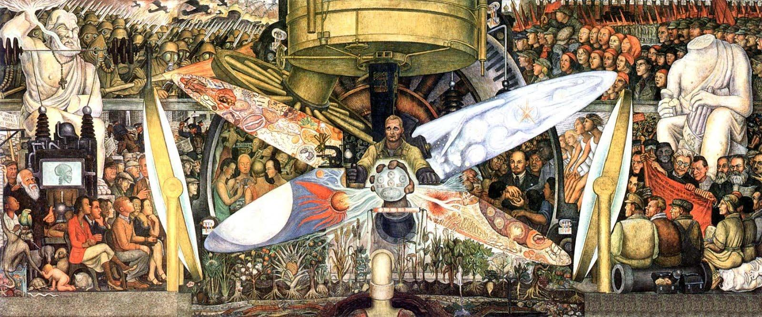
" Man at the crossroad"
Famous US mural in Radio City at the Rockefeller Center in New York
The mural was destroyed because it portrayed Lenin, the first leader of the Soviet Union

Slide 8
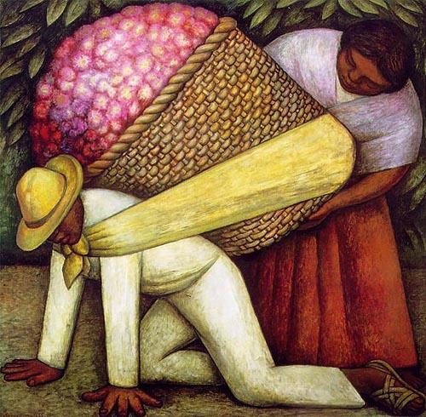
"The Flower Carrier"

Slide 9
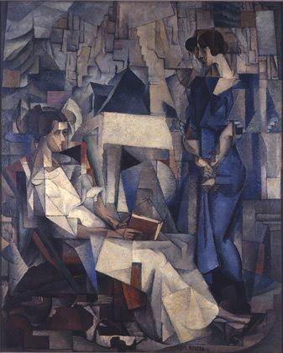
Cubist Art
Dos mujeres, 1914

Slide 10
Resources
http://en.wikipedia.org/wiki/Diego_Rivera#Career_in_Mexico
http://www.gardenofpraise.com/art24.htm
http://www.wfu.edu/history/StudentWork/fysprojects/kmason/Xroads.htm
http://www.wfu.edu/history/StudentWork/fysprojects/kmason/DgoRiv.htm
http://www.biography.com/people/diego-rivera-9459446
http://myhero.com/go/hero.asp?hero=DiegoRivera
http://literatureartmusiclife.blogspot.com/2009/06/diego-riveras-cubist-period.htm
http://www.diego-rivera.org/article6-diego-rivera-influences.htmll

