Slide 1
The Holocaust
Naomi, Moncerrat, Xia, and Qurel

Slide 2
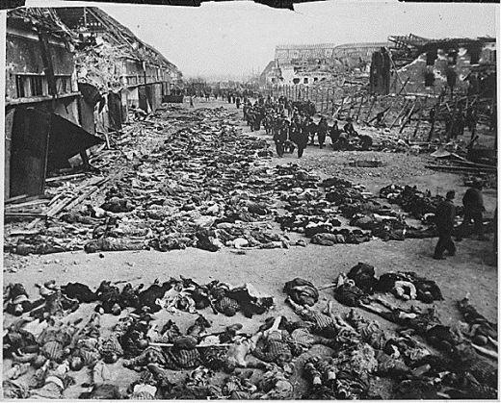
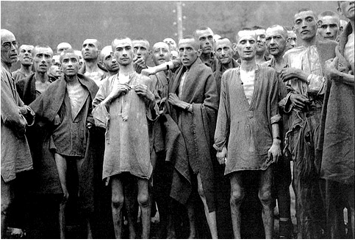
Summary
Began 1939, ended 1945
11 million killed, 6 million were Jewish
Led by Adolf Hitler
Systematic mass murder

Slide 3
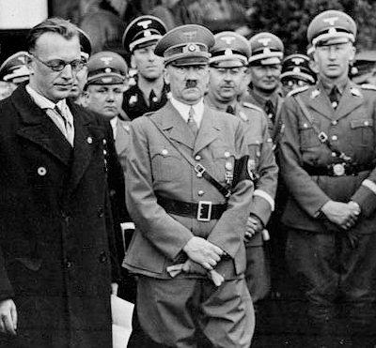
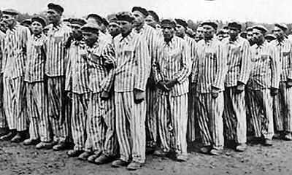
Perpetrators and victims
Perpetrators: Nazi (National Socialist German Workers' Party)
Victims: Jewish, homosexuals, Afro-Germans, Romas, leftists, Slavs(Russians, Poles, Czechs, etc), disabled, mentally ill, Jehovah Witnesses

Slide 4
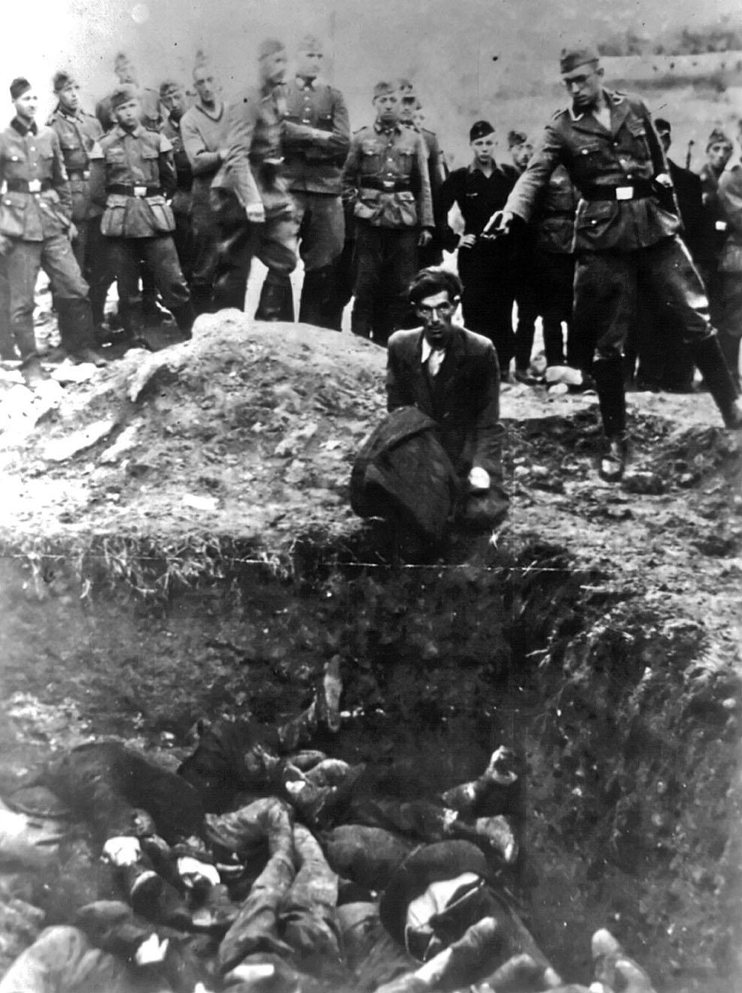
Why were the victims targeted
Blamed for the loss of WW1
Ethnic cleansing, Aryan race (Pure German People)
Antisemitism

Slide 5
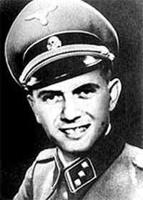
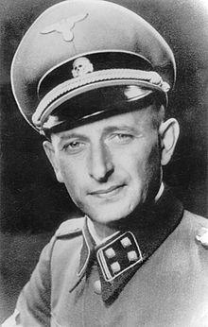
What is was like for victims
Some fled
Nuremberg laws
Jewish required to wear yellow star of David
Placement in ghettos
Sent to concentration and death camps
Medical experiments, starvation, diseases
Gas chambers, direct shooting, hanging
Josef Mengele "Angel of Death"
Adolf Eichmann

Slide 6
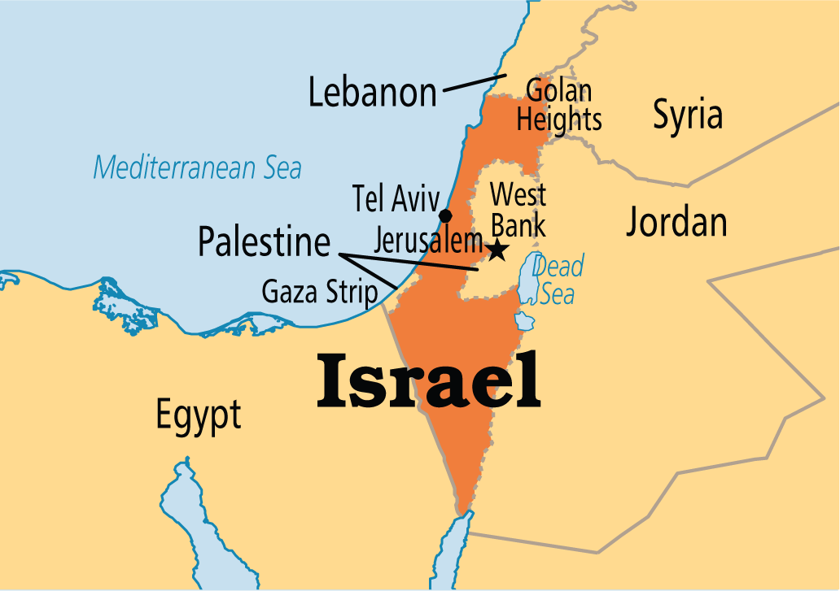
Effects on countries
Immigration of Jewish caused stricter immigration policies
Members of the international community of the Jews established a Jewish homeland, the state of Israel was established in 1948

Slide 7
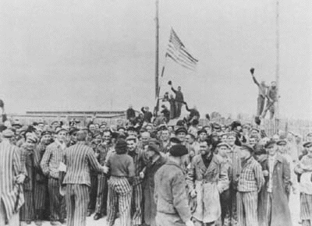
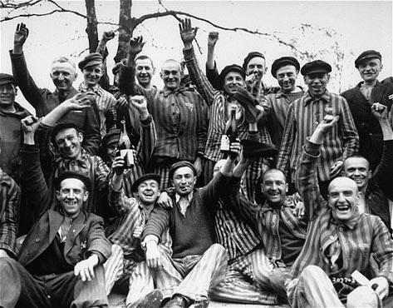
End of the Holocaust
1945; the Allies won the war against Germany
Allies included: U.S., Britain, France, China, Canada, Australia, etc.

Slide 8
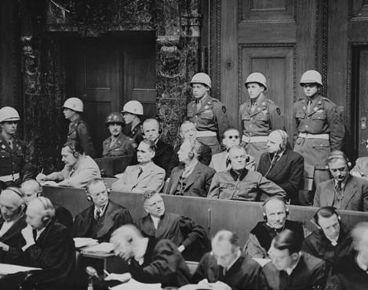
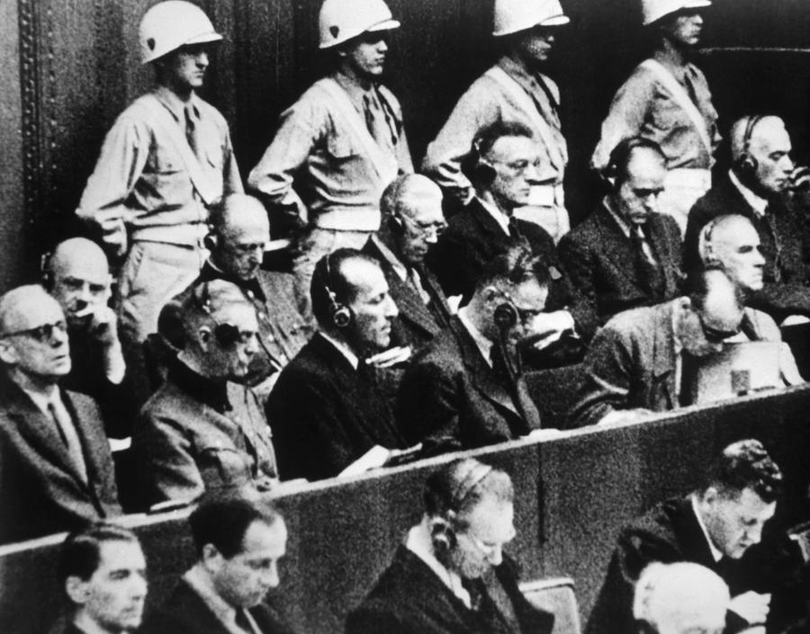
Nuremberg Trials
Took place from 1945-1949
U.S., Britain, France, Soviet Union
Adolf Hitler, Heinrich Himmler, and Joseph Goebbels committed suicide before
24 Nazi officials were tried for crimes against humanity, war crimes, crimes against peace
12 were sentenced to death

Slide 9
Connection to Armenian Genocide
Both genocides were systematic
Ethnic cleansing, targeted religious minorities
Armenians were sent to concentration camps
Large death toll, 1.5 milllion
Armenian Holocaust methods "inspired" Hitler
Hitler believed his genocide was the most successful because it was the largest. "Who after all speaks today of the annihilation of the Armenians?"- Hitler, August 22, 1939

