Slide 1
“Living oceans and coast”
By: Xia, Islam, Zertron

Slide 2
CLIENT
They want a building resembling “The Living Ocean and Coast”
Our design must be made up of arcs.
Arcs should be visible on all for sides including the floor/roof.

Slide 3
Solution
We made a building of a shark.
Made arcs visible on all four sides including the roof.
On the sides, the arcs forms the sharks gills.
On the back it forms the tail.

Slide 4
Our Front Design

Slide 5
Our Side Design

Slide 6
Our Back Design

Slide 7
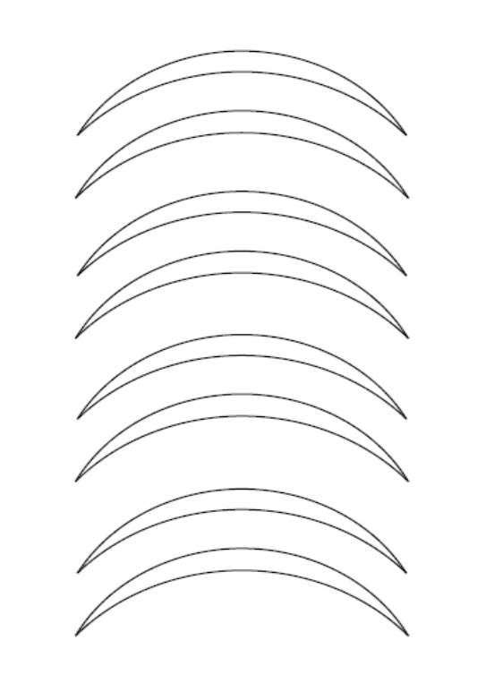
Our Roof Design

Slide 8
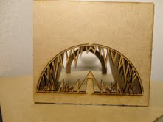
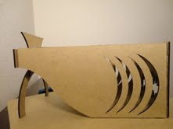
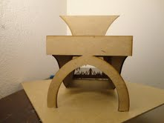
Final Product

Slide 9
Conclusion
Our client wanted a theme of “The Living Ocean and Coast” so that’s what we gave them.
They wanted all parts to be form of arcs.
The building is a shark and it resembles the ocean.

